Slide 1
Putting Research on Technology in Mathematics Education to Work to Inform Teaching and Learning of Algebra
Rose Mary Zbiek, The Pennsylvania State University
16 January 2013
Mathematics Education Colloquium, Michigan State University

Slide 2
Agenda
Biases and Background
Literature Landscape
Questions and Cluster

Slide 3
Research and Teaching
Research
Practice
Research
Research
Research
Practice
Practice
Practice

Slide 4
Basic Biases
Using Literature
Using Research
Laundry lists are inadequate.
Summaries are helpful.
Syntheses are useful.
Digging more deeply into the literature and probing beyond the surface is necessary.
Findings
Tasks
Theories
Constructs

Slide 5
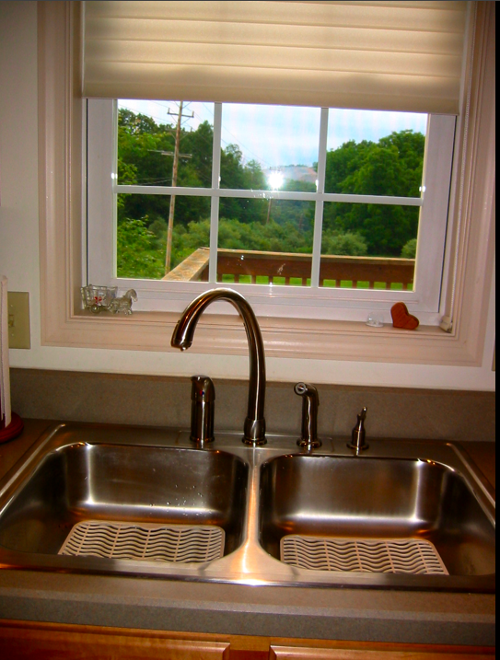
Technology?
Mathematics Technology
Other Technology
Mathematics technology, such as
Calculators
Computer algebra systems (CAS)
Dynamic geometry
Dynamic statistics
Spreadsheets
Applets
Manipulatives
Note: Content and tool lines are blurred.
Communication collaboration technology, such as
Online learning venues
Pedagogical tools, such as
Intelligent tutors
New forms, such as
Classroom collaboration tools
Tablets

Slide 6
Literature Landscape
Motivations
Foci
Develop technology products
Create technology-present curriculum
Fascination with the technology
“Prove” how great technology is
…
Learning, Teaching
Students, Teachers
Performance, Achievement
Strategy, Problem solving
Affect, Motivation, Identity
Policy
…

Slide 7
Literature Landscape
Approach to Algebra
Missing Mountains
Function
(blur with calculus)
Structure
(blur with skills)
Problem solving
Modeling
…
Boundaries can be blurred.
Beginning algebra or Algebra I
Recently developed technologies
Theoretical grounding (more than a taxonomy)
…
We do have vital valleys.

Slide 8
Learning about Functions?
Dominance of graphing calculators in particular and graphing utilities in general
Dominant CAS use as graphing tool
Multiple representations as major issue
Heid & Blume, 2008
Yerushalmy, 2006
Heid, Thomas, & Zbiek, IP

Slide 9
Rule of Four
Graphs
Numbers
Words
Symbols

Slide 10
Rule of Four ±k
Graphs
Graphs
Numbers
Symbols
Symbols
Words
Symbols
Symbols
Symbols

Slide 11
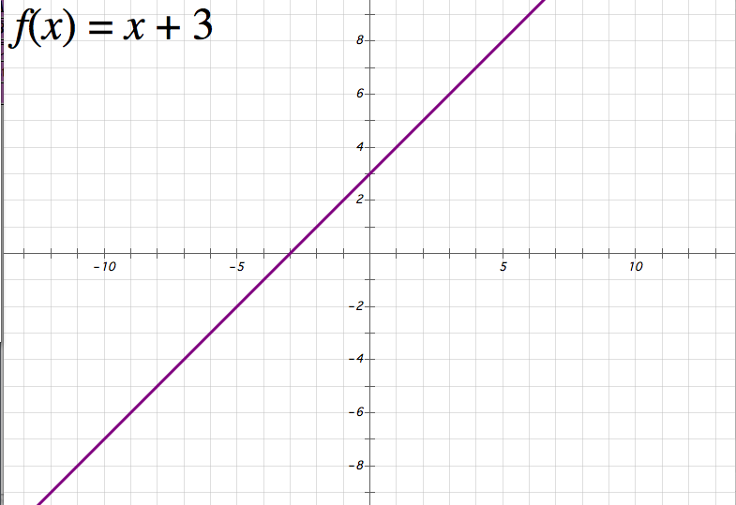
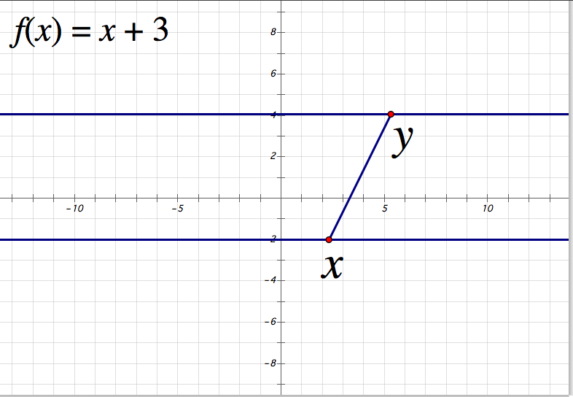
Example: Two Graph Registers
Cartesian
Dynamap/Dynagraph

Slide 12
Rule of Four ±k, Now Linked
Graphs
Graphs
Numbers
Symbols
Symbols
Words
Symbols
Note that technology does not (yet? typically?) connect the words or situation to the other representations.
Symbols
Symbols

Slide 13
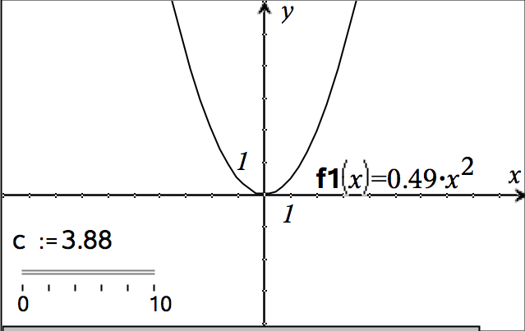
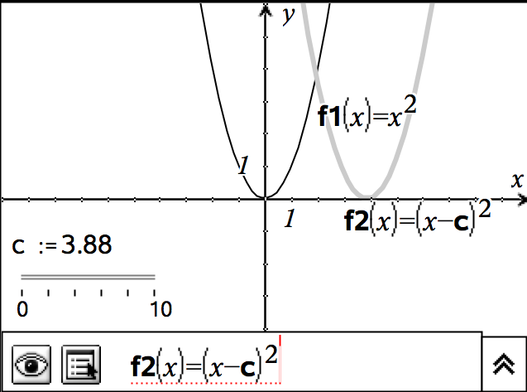
Example: Lots of Links
Bidirectional
Link
Parameter/
Slider

Slide 14
Students with Strong Skills?
… influenced by their confidence in their own algebraic skills, [they are] less likely to consider a machine-generated graph as authoritatively correct.
Were more reluctant to use graphical representations even when the representations provided much more accessible information than a symbolic formula when using a traditional curriculum without technology.
Hart, 1991
Zbiek et al., 2007, p. 1176

Slide 15
Struggling Learners?
Approach to tools
Tend to use tool to replace tedious computations
Leverage tool use to skip something that they could not do on their own
Regarding representations
Delay using symbols
Focus on numerical and graphical methods
Yerushalmy, 2006

Slide 16
Privileging Representations?
Two teachers intensely plan a (calculus) lesson together, including CAS use.
Their enacted lessons look very different.
Their students score similarly in total but use different strategies and different representations.
Offered explanation: The teachers privilege different representational forms.
Kendal & Stacey, 2002

Slide 17
And Preservice Teachers?
Functions can be useful models. How do preservice teachers develop function models?
Four ways of developing a model with function-fitting tool and graphing utility:
Technology determines the model—R² rules.
Choose one of the technology-generated models based on characteristics of families of functions.
Choose function family based on characteristics and then use technology to create and revise symbolic from to match data.
Go for a known or assumed relationship (e.g., “looks like doubling” for the first two data points).
Zbiek, 1998

Slide 18
Points about Multiple Reps
Inhibited by symbolically driven environments
Mathematical feedback in one register might inform work in another register or cause a change in solution path. In particular, mathematical feedback seems important when the goal is to produce symbolic expressions or implement substantial procedures.
Examples of mathematical feedback include match of graph and data, value of R², and unexpected extrema.
Assumes one is looking for connections or links between elements and characteristics of representations.
Hillel, Kieran, & Gurtner, 1989

Slide 19
Learning to Use Technology?
Any technology that we use is another’s artifact. Learners need to make it their tool.
Instrumental genesis is the process of an individual developing a tool-user relationship with the technology. Both the individual’s thinking and the technology can change in the process.
Guin & Trouche, 1999
Verillon & Rabardel, 1995

Slide 20
Teacher Using Technology?
Mishra and Koehler’s TPACK might describe the kinds of knowledge needed.
For the teacher, mathematics technology must become both a mathematics tool and a pedagogical tool.
Play, personal math Use, small scale Recommended use with students, larger scale Implementation with classes, and Assessment of the innovations (PURIA) are potential phases through which even experienced teachers pass.
Teachers develop instrumental orchestrations.
Mishra & Koehler, 2006
Beaudin & Bowers, 1997
Trouche, 2005
Zbiek & Hollebrands, 2008

Slide 21
What about Symbolic Work?
Let’s acknowledge the importance of knowing at least some by-hand procedures.
Question how technology can be used to help students learn and learn about by-hand procedures
Motivation
Reflection

Slide 22
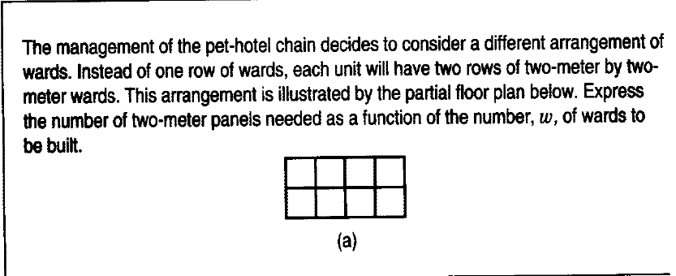
The Pet Ward Task
Heid & Zbiek, 1995, p. 652

Slide 23
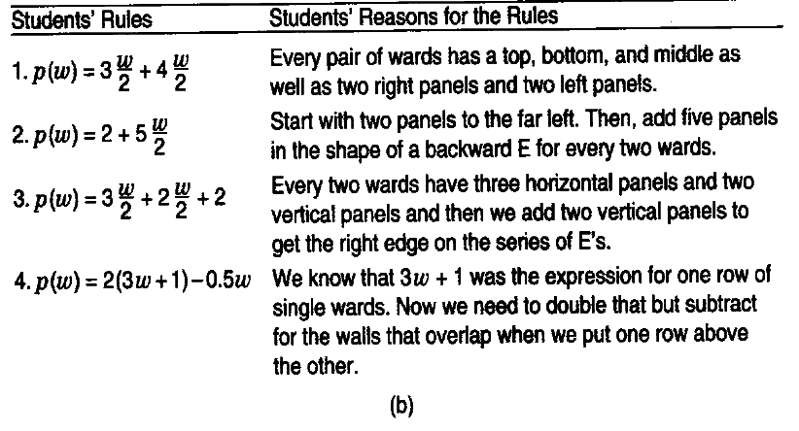
Student Responses
Heid & Zbiek, 1995, p. 652

Slide 24
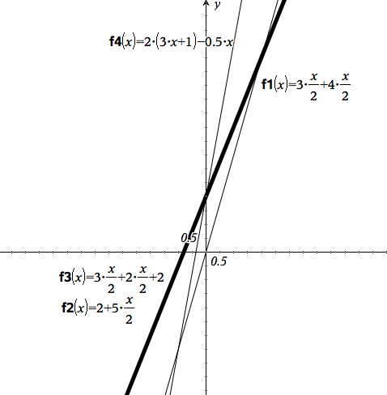
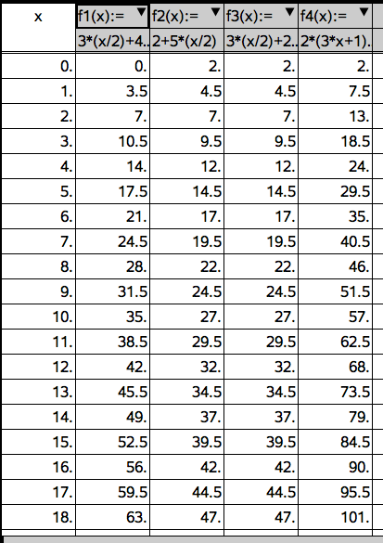
The Representations
This is the first time that students EVER begged me to teach them how to combine like terms!

Slide 25
CIA Results
Learned by-hand methods faster
Learned by-hand methods nearly as well
Appreciated efficiency
“Changed the winners”
Heid & Zbiek, 1995

Slide 26
The Reality
Motivation or attitude bump with the start of technology use might disappear.
Example: CAS use in “college algebra” settings
Zbiek, 2003

Slide 27
Developing Skills, Concepts, … or Techniques?
Developing a model required more the machine procedure, even if it was only reasoning about R².
“technique, the nature of technical capacity that goes beyond rote application of procedures.” (p. 1179, emphasis added)
A technique is a method for carrying out, or the ability to perform, a task. … using a technique involves not only routine work. …complex reasoning is required. (p. 128)
Hitt & Kieran, 2009, p. 128
Zbiek et al., 2007, p. 1179

Slide 28
Tasks to Develop Techniques
Paper and pencil “solution”
CAS “solution”
Reflection and resolution
???
Guzman, Kieran, & Martinez, 2010

Slide 29
CAS, Tasks, and Teacher
Results given by the CAS provoked in students … the use of the CAS in the context of the designed task led the students to rethink their techniques and explanations and provoked a theoretical reflection that could explain for them the results given by the CAS.
However, such theoretical reflection was not enough …. These results thus suggest that, in spite of good tasks and the use of CAS, in order for students to more fully understand rational expressions and their simplification, including the relation between polynomial division and factored forms within rational expressions, the importance of teacher intervention is inescapable.
Guzman, Kieran, & Martinez, 2010, p. 1501

Slide 30
Points about Procedures
Technology is good for more than checking answers.
Results that challenge and intrigue students can motivate students to reason about symbolic procedures, including procedures that the students have not yet acquired.
Tasks are carefully chosen and sequenced for use with the technology, and the tasks demand resolution of a mathematical dilemma in the students’ eyes.
Teacher prompts reasoning and reflection to go beyond procedure and into technique.

Slide 31
Connected Technology?
That’s all good with individual handhelds and desktops. What happens when mathematics technology blends with communication/collaboration technology?
“Show your work” and “look at our work.”
Within-multi-representations these focus on the interactions of students with the multi-representations supported by the software itself (e.g. TI-Nspire) … produced by a single student or by a small group of students using the same device.
Between-multi-representations these principally focus on the interactions that the instrument (e.g. TI-Navigator) triggers and supports amongst students in the classroom, because of the simultaneous access on the shared screen to the solutions produced by different students for the same task.
Arzarello & Robutti, 2010

Slide 32
There’s More than Algebra?
Research that does not directly address algebra (or function) can offer useful constructs.
An example:
“Drag” in dynamic geometry environments → Dynamic CAS or graphing settings

Slide 33
“Drag” in Dynamic Geometry
Wandering dragging, a somewhat random type of dragging in which the student’s goal is to search for regularities or interesting results that occur when some object is dragged.
Lieu muet dragging (dragging in which the student tacitly or explicitly maintains some condition), the student’s goal is to preserve some regularity in the drawing.
Dragging test (dragging to test a hypothesis), has a different goal, namely, to determine whether a conjecture (the student’s or someone else’s) is true.
Arzarello et al., 1998

Slide 34
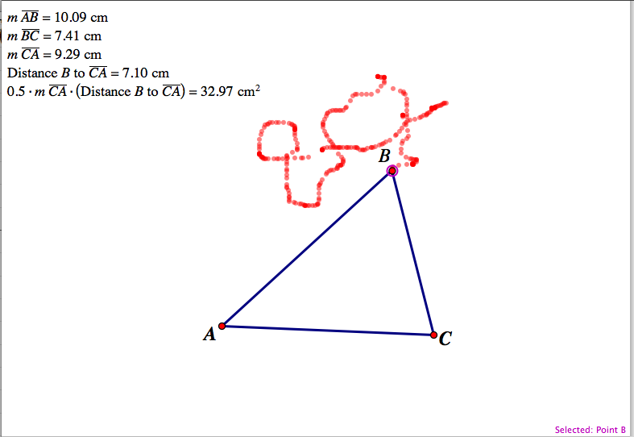
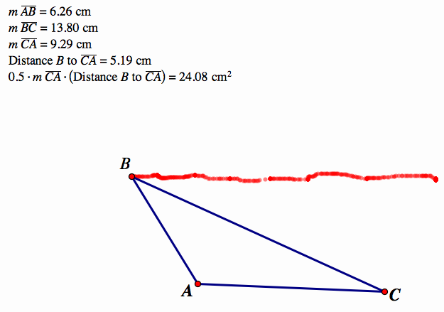
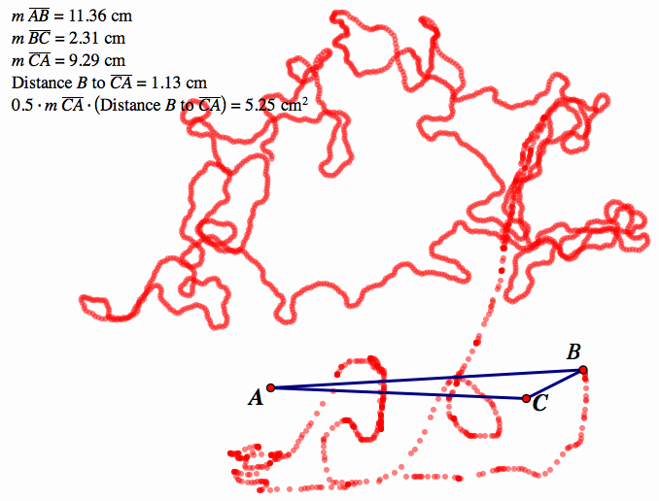
Examples of DGE Dragging
Dragging test
Lieu muet
Wandering

Slide 35
Parallels in “DAE*”
Guin and Trouche (1999) observed in weaker students aged 15 to 16 “avoidance strategies” such as random trials and “zapping” to other commands in the same menu, similar to what Ball and Stacey (2005) reported.
Guin & Trouche, 1999
Ball & Stacey, 2005,
Zbiek et al., 2007, p. 1185
DAE: My suggestion that we need to think about “dynamic algebra environments”

Slide 36
Examples of DGE Dragging
Dragging test
Lieu muet
Wandering

Slide 37
Help for Learners?
Feedback can alert user to an error but might not help the user to know why the error exists.
Tutoring programs / intelligent tutors
Possibility that pedagogical technology blends with mathematical technology
Koedinger, 1998

Slide 38
In Summary…
All those representations are great but the student, not only the technology, needs to link them. Linking is more than translation; it requires connecting elements and characteristics.
Reasoning and procedure thrive in harmony for students to develop mathematical/statistical models and techniques.
Symbols are a challenge for some students. Symbols in technology settings can be overdone or underprivileged.
Students and teachers develop a relationship to technology.
Mathematical and pedagogical feedback can be great if students use it, and it should be rationale beyond judgment.

Slide 39
Lurking Questions
What are the effects on understanding of function, procedures, modeling, and other things of representations that are fully bi-directionally linked in technology?
How can students capitalize on linked multiple representations and mathematical feedback
To develop robust understanding of symbols?
To develop representational fluency?
To develop techniques?
Sandoval, Bell, Coleman,
Enyedy, & Suthers, 2000
Zbiek et al., 2007

Slide 40
Lurking Question
What about technology environments that blend mathematics technology with other kinds of technology?

Slide 41
LURKING Question
How much of what by-hand content needs to be learned?

Slide 42
And the story continues…
Research
Practice
Thank you!
rmz101@psu.edu

Slide 43
References
Arzarello, F., & Robutti, O. (2010). Multimodality in multi-representational environments. ZDM (42), 715 – 731.
Arzarello, F., Micheletti, C., Olivero, F., Robutti, O., Paola, D., & Gallino, G. (1998). Dragging in Cabri and modalities of transition from conjectures to proofs in geometry. In A. Olivier & K. Newstead (Eds.), Proceedings of the 22nd conference of the International Group for the Psychology of Mathematics Education (Vol. 2, pp. 32–39). South Africa: University of Stellenbosch.
Ball, L., & Stacey, K. (2005). Teaching strategies for developing judicious technology use. In W. J. Masalski & P. C. Elliott (Eds.), Technology-supported mathematics learning environments, 2005 Yearbook of the National Council of Teachers of Mathematics (pp. 3–15). Reston, VA: National Council of Teachers of Mathematics.
Beaudin, M. & Bowers, D. (1997). Logistics for facilitating CAS instruction. In J. Berry, J. Monaghan, M. Kronfellner, & B. Kutzler (Eds.), The state of computer algebra in mathematics education (pp. 126–135). Lancashire, England: Chartwell-York.
Guin, D., & Trouche, L. (1999). The complex process of converting tools into mathematical instruments: The case of calculators. International Journal of Computers for Mathematical Learning, 3, 195–227

Slide 44
References (continued)
Guzmán, J., Kieran, C., & Martinez, C. (2010). The role of computer algebra systems (cas) and a task on the simplification of rational expressions designed with a technical-theoretical approach. In Brosnan, P., Erchick, D. B., & Flevares, L. (Eds.), Proceedings of the 32nd annual meeting of the North American Chapter of the International Group for the Psychology of Mathematics Education (pp. 1497-1505). Columbus, OH: The Ohio State University.
Hart, D. (1991). Building concept images: Supercalculators and students’ use of multiple representations in calculus (Doctoral dissertation, Oregon State University, 1991). Dissertation Abstracts International 52(12), 4254.
Heid, M. K., & Blume, G. W. (2008). Technology and the development of algebraic understanding. In M. K. Heid & G. W. Blume (Eds.), Research on technology and the teaching and learning of mathematics: Syntheses, cases, and perspectives. Vol. 1: Research syntheses (pp. 55-108). Charlotte, NC: Information Age Publishing.
Heid, M. K., Thomas, M., & Zbiek, R. M. (in press). How might computer algebra systems change the role of algebra in the school curriculum? In M. A. Clements, A. Bishop, C. Keitel, J. Kilpatrick, & F. Leung (Eds.) Third International Handbook of Mathematics Education. Dordrecht, The Netherlands: Springer.

Slide 45
References (continued)
Heid, M. K., & Zbiek, R. M. (1995). A technology-intensive approach to algebra. Mathematics Teacher, 88(8), 650-656.
Hillel, J., Kieran, C., & Gurtner, J. (1989). Solving structured geometric tasks on the computer: The role of feedback in generating strategies. Educational Studies in Mathematics, 20, 1-39
Hitt, F., & Kieran, C. (2009). Constructing knowledge via a peer interaction in a CAS environment with tasks designed from a Task-Technique-Theory perspective. International Journal of Computers for Mathematical Learning, 14, 121-152. (available from Springer On-line)
Kendal, M., & Stacey, K. (2002). The impact of teacher privileging on learning differentiation with technology. International Journal of Computers for Mathematical Learning, 6(2), 143-265.
Koedinger, K. R. (1998). Conjecturing and argumentation in high-school geometry students. In Lehrer, R., & Chazan, D. (Eds.), Designing learning environments for developing understanding of geometry and space (pp. 319-348). Mahwah, NJ: Lawrence Erlbaum.
Mishra, P., & Koehler, M. J. (2006). Technological Pedagogical Content Knowledge: A new framework for teacher knowledge . Teachers College Record. 108 (6), 1017-1054.

Slide 46
References (continued)
Sandoval, W. A., Bell, P., Coleman, E., Enyedy, N., & Suthers, D. (2000, April). Designing knowledge representations for epistemic practices in science learning. Paper presented at the annual meeting of the American Educational Research Association, New Orleans, LA.
Trouche, L. (2005). Instrumental genesis, individual and social aspects. In D. Guin, K. Ruthven, & L. Trouche (Eds.), The didactical challenge of symbolic calculators (pp. 197-230). New York: Springer.
Verillon, P., & Rabardel, P. (1995). Cognition and artifacts: A contribution to the study of though[t] in relation to instrumented activity. European Journal of Psychology in Education 9, 77–101.
Yerushalmy, M. (2006). Slower algebra students meet faster tools: Solving algebra word problems with graphing software. Journal for Research in Mathematics Education, 37, 356-387.
Zbiek, R. M. (1998). Prospective teachers' use of computing tools to develop and validate functions as mathematical models. Journal for Research in Mathematics Education, 29(2), 184-201.

Slide 47
References (continued)
Zbiek, R. M. (2003). Using research to inform teaching and learning with computer algebra systems. In J. T. Fey, A. Cuoco, C. Kieran, L. McMullin, & R. M. Zbiek (Eds.) Computer algebra systems in mathematics education (pp. 197-216). Reston, VA: National Council of Teachers of Mathematics.
Zbiek, R. M., Heid, M. K., Blume, G. W., & Dick, T. (2007). Research on technology in mathematics education: A perspective of constructs. In F. Lester (Ed.), Second handbook of research on mathematics teaching and learning (pp. 1169-1207). Charlotte, NC: Information Age.
Zbiek, R. M., & Hollebrands, K. (2008). A research-informed view of the process of incorporating mathematics technology into classroom practice by inservice and prospective teachers. In M. K. Heid and G. W. Blume (Eds.), Research on technology and the teaching and learning of mathematics: Volume 1 (pp. 287-344). Charlotte, NC: Information Age.

