Slide 1
Mathematical Problem-Posing Based Learning (P-PBL):
Theoretical Considerations and Empirical Research
Jinfa Cai
Texas A&M University
jfcai@tamu.edu

Slide 2
Many Thanks to
C. Davis, Sara Elakesh, Ayesha Bundy, & Betty Phillips
for the invitation

Slide 3
LieCal and P-PBL Projects
ESI-0114768
ESI-0454739
DRL-1008536
DRL-2101552
DRL-2604452

Slide 4
Cai, J., Moyer, J.C., Wang, C., Wang, N. & Nie, B. (2024).
Student learning and instructional tasks in different curricular
contexts: A longitudinal study.
International Journal of Educational Research. 125,
102329.

Slide 5

Supporting Teachers to Teach Mathematics Through Problem Posing: An Early-Stage Longitudinal Study (in Middle Grades) (DRL- 2101552)

Slide 6
Thanks to My Team
Jinfa Cai, PI and Director
Faith Muirhead & Amy Brown, co-PIs (Michelle Cirillo)
Stephen Hwang, Senior research associate and project coordinator
J.P. Han, Burak ölmez, & Hua Ran, postdocs
Victoria Robinson, research specialist
Yue Ma, Matt Melville, Steve Silber, GRAs
Simon Glover, Jenna Paltenstein, Undergraduate RAs

Slide 7
Collaborative Research: AI-Enhanced Problem-Posing Based Learning: Supporting Mathematics Teachers’ In-the-Moment Instructional Decision-Making (DRL-2604452) (with Xiaoming Zhai, UGA)

Slide 8
Past

Slide 9
Historical Development
Pólya (1945): “Looking back” to generate problems.
Butts (1980): Motivation through formulation.
Brown & Walter (1983): What-If-Not strategy.
Kilpatrick (1987): Argued for studying how problems are posed.
NCTM (1989, 1991): Included problem posing in national standards.
Ellerton (1986), Lin (1980)……
Silver (1994): On Mathematical Problem Posing

Slide 10
Silver’s Six Themes
Creativity or exceptional ability
Inquiry-oriented instruction
Core feature of mathematical activity
Improves problem-solving ability
Reveals students’ understanding
Improves disposition toward mathematics

Slide 11
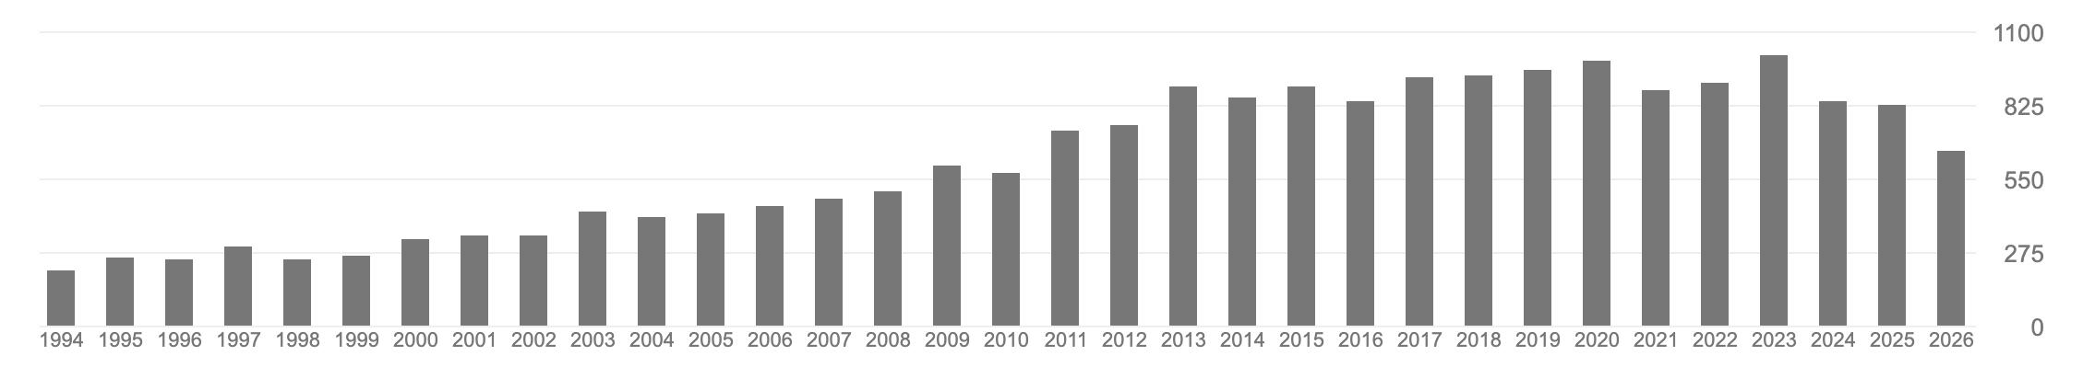
Citation Trends
Publications Citing Silver (1994) by Publication Year and Type (1994-2026)

Slide 12
Historical Development
ICME-14: First time having a TSG with problem posing
ICME-15: TSG with PP & DG on PP.
Special Issues: Six
Meta-analysis: Six.
Ran, H., Cai, J., Hwang, S., Han, J., Ma, Y., & Muirhead, F. (2025). Effects of engaging in problem-posing interventions on learners’ cognitive mathematics outcomes: a comprehensive meta-analysis. Journal for Research in Mathematics Education. 56 (5), 259–282.

Slide 13
Historical Development
Singer, F. M., Ellerton, N. F., & Cai, J. (Eds). (2015). Mathematical problem posing: From research to effective practice. Springer.
Felmer, P., Pehkonen, E., & Kilpatrick, J. (2016). Posing and solving mathematical problems: Advances and new perspectives. Springer
Toh, T.-L., Santos-Trigo, M. et al. (Eds.). (2023). Problem Posing and Problem Solving in Mathematics Education. Springer
Cai, J., & Leikin, R. (Eds) (2026). Research in mathematical problem posing: New advances and directions. Springer.

Slide 14
Present

Slide 15
For the linear Function y = 6x + 5, list two ordered pairs.
“The lesson did not go all that well. While most of the students were able to plot points, many had no idea why the "order" in ordered-pair matters. They had never seen quadrants, and many did not understand how to answer the question regarding the signs of the ordered pairs in the quadrants and no student realized that there is a zero involved if the point is on an axis. The idea of producing ordered pairs for a function was beyond the grasp of all but a few of the students. MUCH WORK TO DO!”

Slide 16
Given the linear function, y = 6x + 5, what could this represent a real-life scenario?
Pose an easy mathematical problem and a challenging mathematical problem which can be solved based on your real-life scenario.

Slide 17
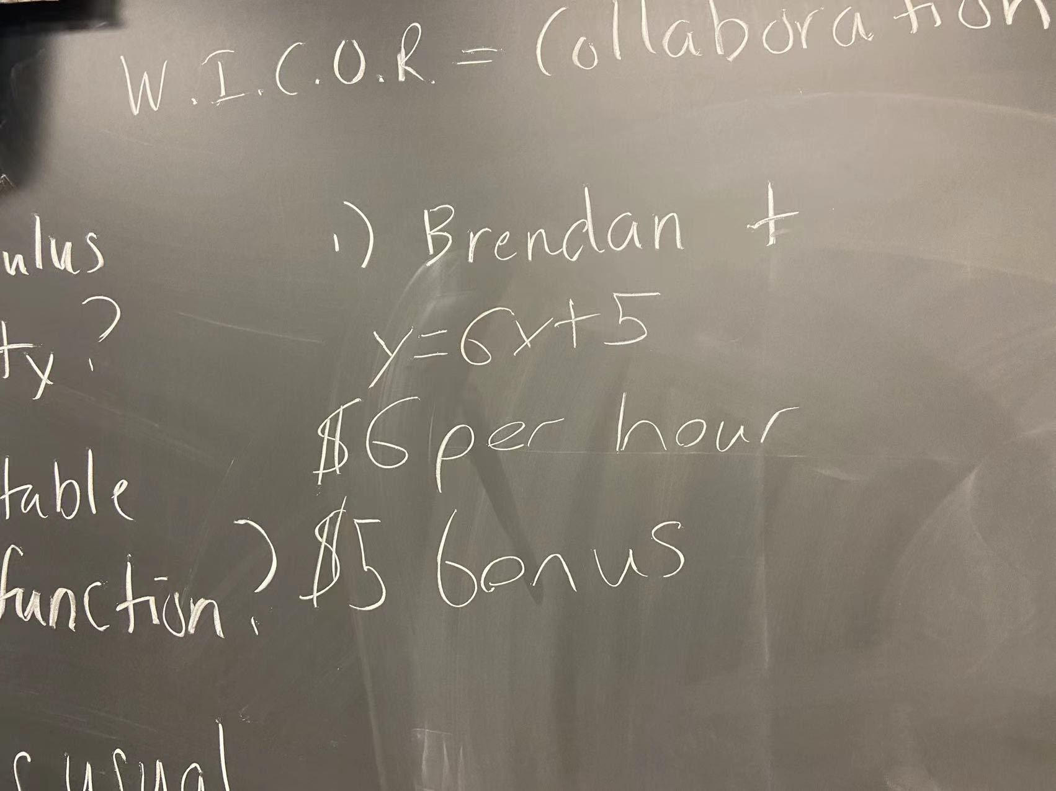
Y = 6x + 5
$6 per hour
$5 bonus

Slide 18
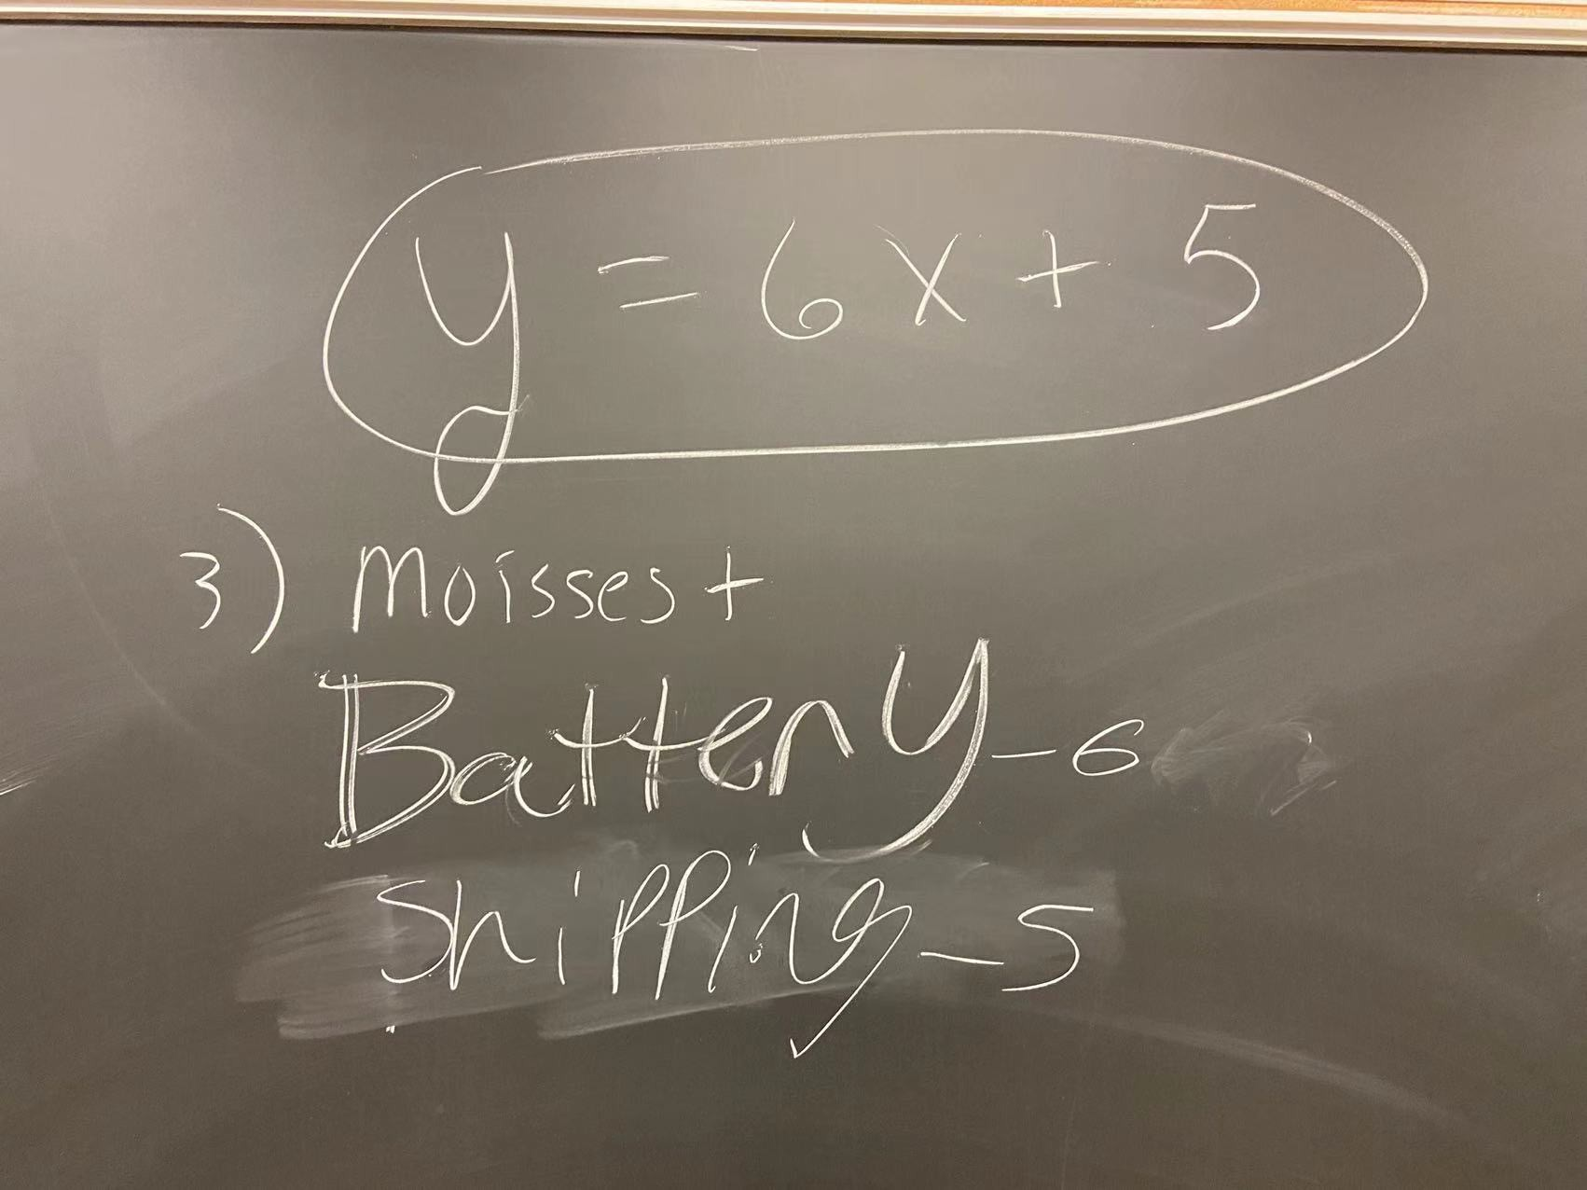

Slide 19
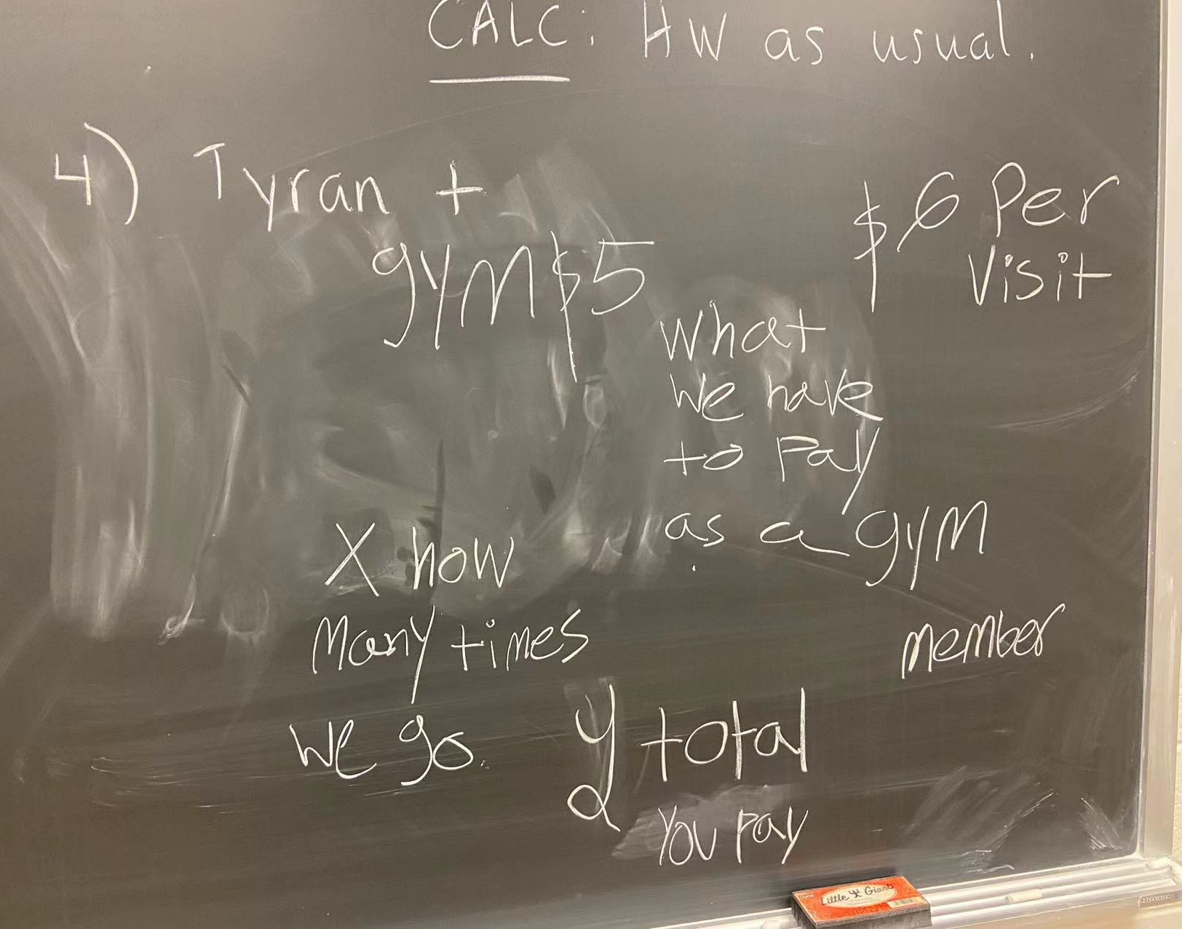
Gym, $5
What we have to pay as a gym member
$6 per visit
X: how many times you go
Y: total you pay

Slide 20
Proportion of Mathematical Problems
for Each Task (Silber & Cai 2021)
 | Task 1 | Task 2 | Task 3 | Task 4
High Performing (Grades A&B) (n = 57) | 89% | 100% | 98% | 96%
Average Performing (Grade C) (n = 36) | 100% | 97% | 100% | 100%
Low Performing (Grades D&F) (n = 42) | 69% | 95% | 100% | 95%

Slide 21
Proportion of Responses That Invoked Mathematical Ideas for the Graph Task
 | Non-zero y-intercept | Covariation | ½ as the slope
High Performing | 43% | 64% | 14%
Average Performing | 33% | 50% | 0%
Low Performing | 26% | 63% | 16%

Slide 22
Students’ Reactions
I think [problem posing] gives a new perspective. It makes you think about it in a different way, makes you more familiar with the mathematics principles behind the questions.
You’re looking at the entirety of the information given, whereas if you’re given a question, you’re only going to give it a quick glance for what’s relevant to what it’s asking. You might not understand the big picture of how the problem works. Whereas if we [pose problems], you’re sort of seeing the entirety of it.
Silber, Cai & Hwang, 2026

Slide 23
Why Problem Posing?
It can increase students’ access (or opportunity) to mathematical sensemaking and learning.
Low floor high ceiling

Slide 24







Teaching Mathematics Through Problem Posing
Instructional Tasks
as set up by teachers
Instructional Tasks as implemented in the classroom
Classroom Discourse
Students’ Learning
Teachers’ Planning, Beliefs, and Knowledge
Learning Goals for Students, Math Tasks in curricular materials

Slide 25







With the following numbers and symbol, please pose one easy problem and one challenging problem involving percentages.

Slide 26
This task is used to review the unit of percent
Students pose problems individually
Students present their posed problems
Teacher writes down students’ posed problems on the board in different categories (Park & Leinhardt, 1995)
Teacher and students solve selected problems

Slide 27
By problem posing in mathematics education, we refer to several related types of activities that entail or support teachers and students formulating (or reformulating) and expressing a problem or task based on a particular context (which we refer to as the problem context or problem situation). (Silver, 1994)

Slide 28

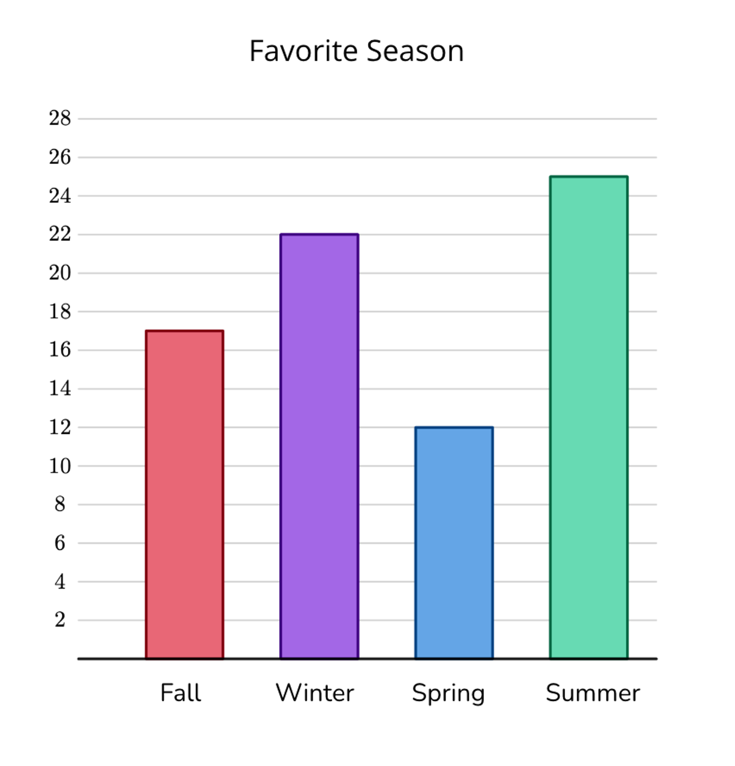
How many students are represented in the graph?
How many fewer students chose summer than fall and spring combined?

Slide 29


Pose one easy math problem and one challenging math problem that can be solved using this information.

Slide 30

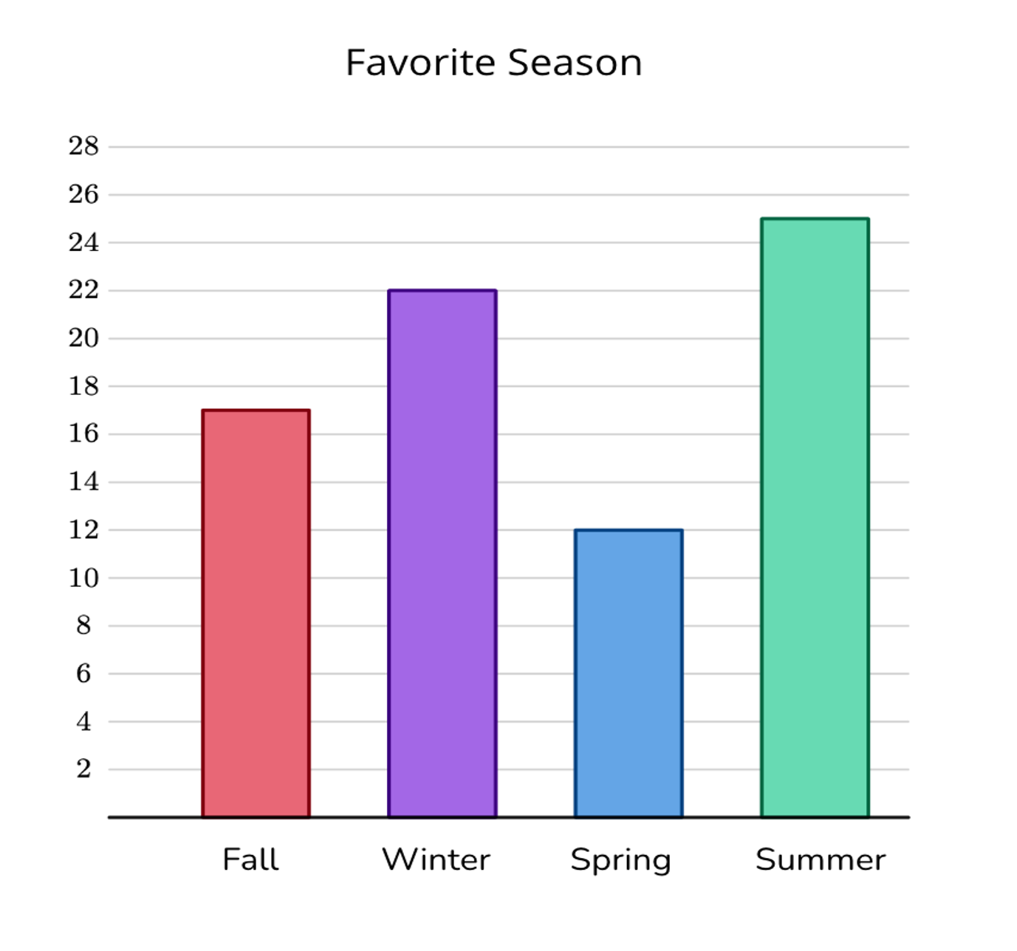
Pose one easy math problem and one challenging math problem that can be solved using this information.
How many students are represented in the graph?
How many fewer students chose summer than fall and spring combined?

Slide 31
Problem-Posing Tasks
Situations
Prompts

Slide 32
Words/text
Problem situation
Real-life context
Picture/figure/graph
Table
Mathematical expression
Picture/figure/graph
Purely mathematical context
Table
Pattern

Slide 33

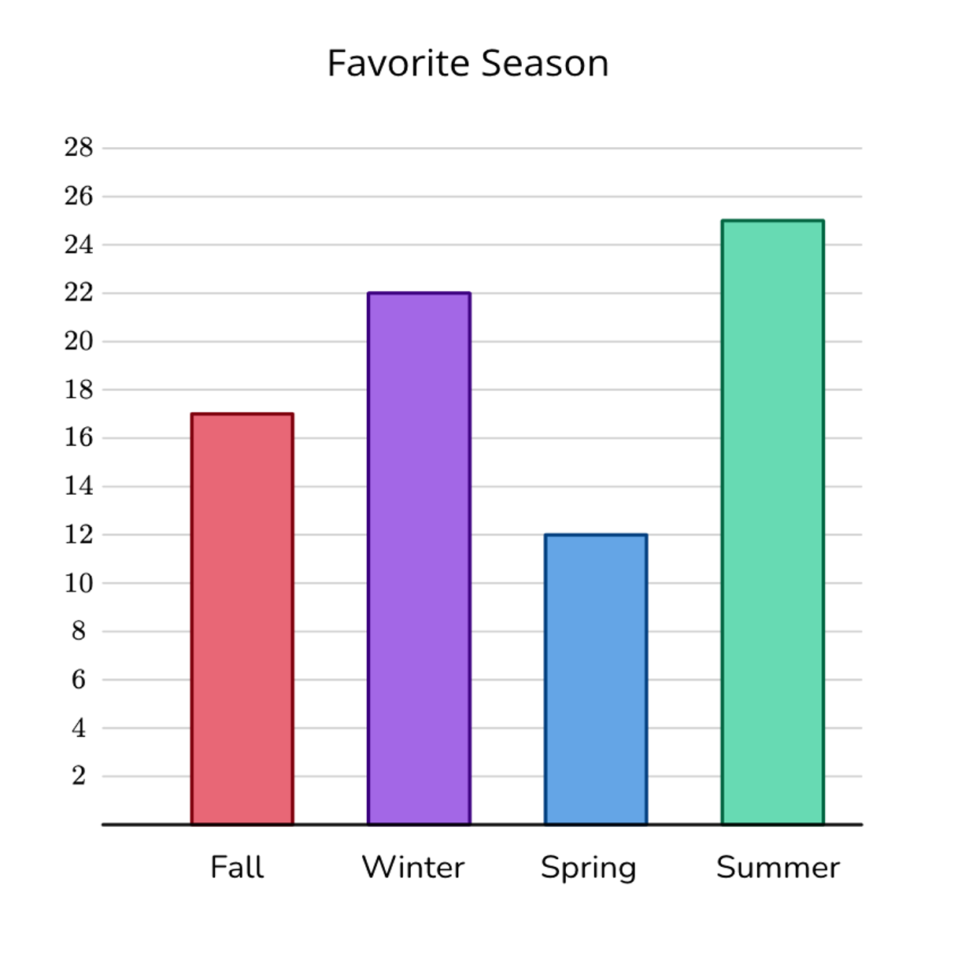
Problem-posing Prompts
Prompt A: Pose three different mathematical problems that can be solved using this information.
Prompt B: Pose one easy mathematical problem, one moderately difficult mathematical problem, and one difficult mathematical problem that can be solved using this information.
Prompt C: Pose three mathematical problems to challenge your teachers to solve.

Slide 34
Three Strategies for Designing Problem-Posing Tasks
Delete question(s) and ask for problem posing
Pose additional mathematical problems
Introduce new situations and pose
mathematical problems

Slide 35
How many students are represented in the graph?
How many fewer students chose summer than fall and spring combined?

Slide 36
P-PBL Instructional Model
Real life
Mathematics Other
Step 1: Teacher presents the situation
Quantity
Difficulty Other
Step 2: Teacher presents the problem-posing prompt
Independent
Small Group
Step 3: Students pose problems
Analyze
Select
Sequence Solve
Step 4: Teacher and students handle posed problems
Cai, 2022

Slide 37
P-PBL Instructional Model
Real life
Mathematics Other
Step 1: Teacher presents the situation
Quantity
Difficulty Other
Step 2: Teacher presents the problem-posing prompt
Independent
Small Group
Step 3: Students pose problems
Analyze
Select
Sequence Solve
Step 4: Teacher and students handle responses
Cai, 2025

Slide 38
Situation Matters
Task features shape outcomes (Rosli et al., 2013; Yao et al., 2021) Key variables include:
  context,
  openness,
  personalization,
  structure (numerical vs. non-numerical)
Need to balance structure and flexibility.
Personalization boosts relevance (Walkington & Bernacki, 2015)

Slide 39
Situation Matters
Structured, numerical tasks → better understanding (Leung & Silver, 1997, Silber & Cai, 2017; Zhang et al., 2022)
Informal contexts → more diverse problems (English, 1998)
Personalized tasks → increased engagement (Krawitz et al., 2024)

Slide 40
Leung & Silver (1997)
Situations
With or without numerical information Results:
The teachers performed better on tasks that included specific numerical information than on tasks without specific numerical information.

Slide 41
Prompt Variations
Prompts shape the complexity of posed problems (Cai et al., 2023).
Examples:
  Pose-EMD: Pose Easy, Medium, Difficult problems
  Pose-SD: Pose problems Similar to and Different from a given problem
Prompts influence depth and linguistic complexity.

Slide 42
How do students interpret these prompts?
Prompt A: Pose three different mathematical problems that can be solved using this information.
Prompt B: Pose one easy mathematical problem, one moderately difficult mathematical problem, and one difficult mathematical problem that can be solved using this information.
Prompt C: Pose three mathematical problems to challenge your teachers to solve.

Slide 43
Further research – Task variables (Cai et al., 2024)
How can systematic variation of PP situations and prompts inform our understanding of the relationship between PP processes and products as well as relationship between PP and PS?
How do student-related variables (e.g., knowledge, affect, experiences) interact with task-related PP variables?
How do problem-posing tasks (with variations) influence students’ beliefs about mathematics?
How do problem-posing tasks (with variation) influence students’ sense-making and motivation about mathematics?

Slide 44
Step 1: Teacher presents the situation
Real life
Mathematics Other
Quantity
Difficulty Other
Step 2: Teacher presents the problem-posing prompt
Independent
Small Group
Step 3: Students pose problems
Analyze
Select
Sequence Solve
Step 4: Teacher and students handle responses

Slide 45
Models of the problem-posing process
“[…] there is not yet a general problem-posing analogue to well-established general frameworks for problem solving such as Polya’s (1957) four steps”
(Cai et al., 2015, p. 14).

Slide 46
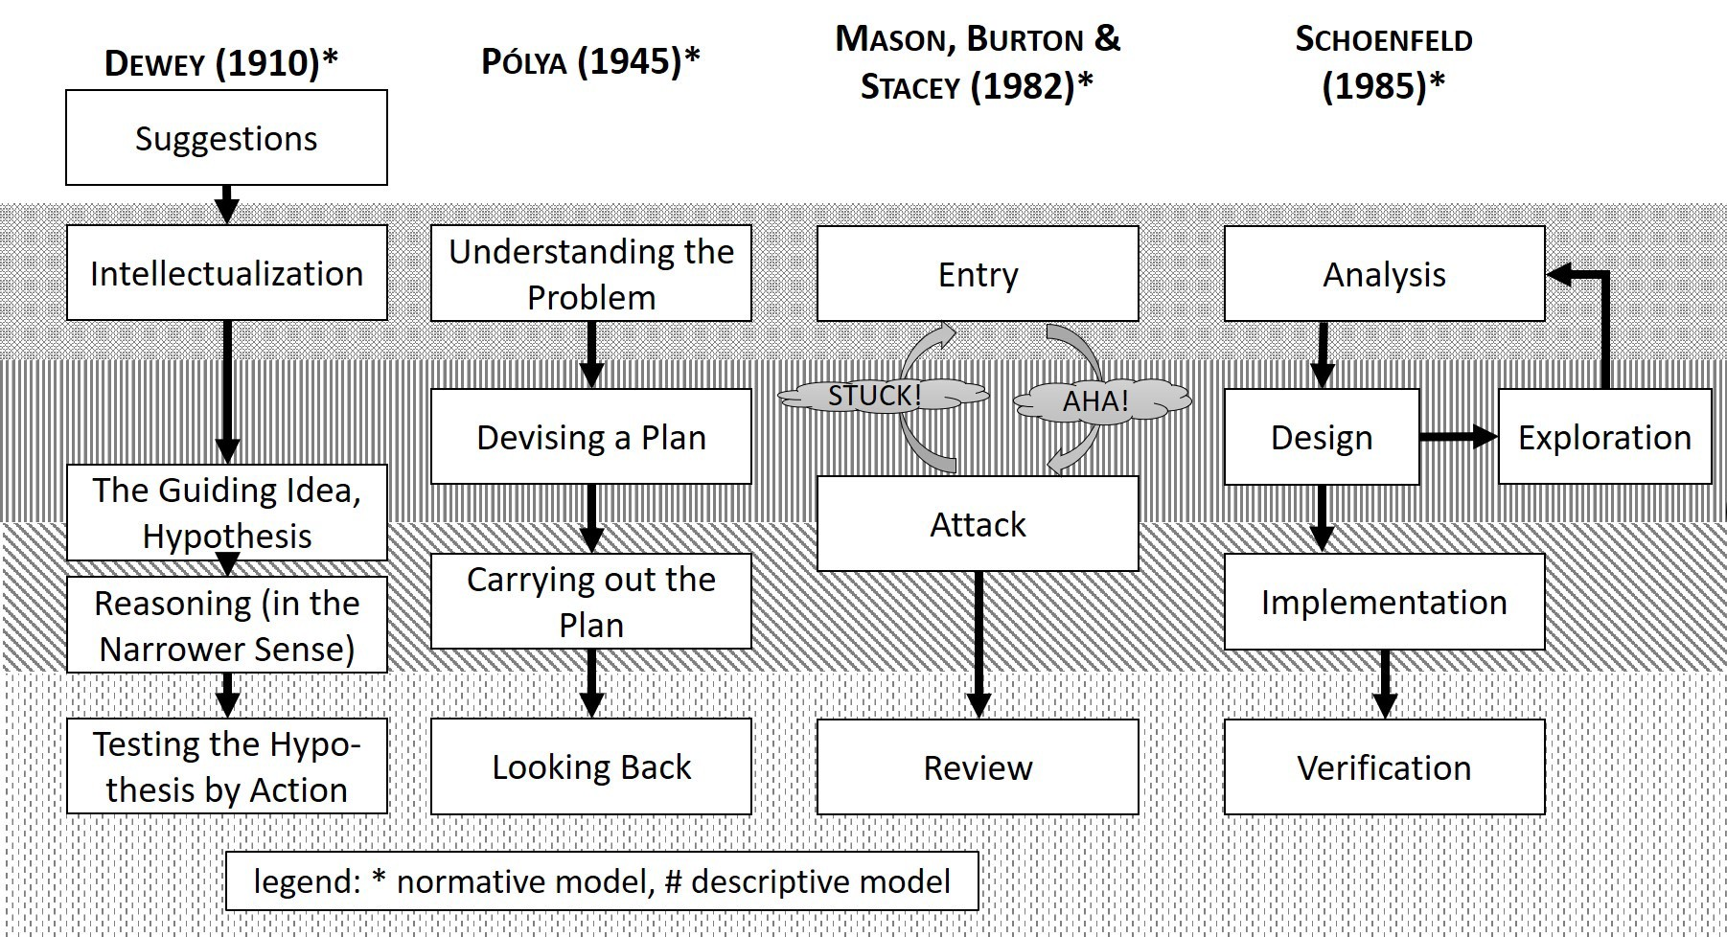
Models of Problem-solving Processes
Rott, B., Specht, B. & Knipping, C. A descriptive phase model of problem-solving processes. ZDM Mathematics Education 53,
737–752 (2021). https://doi.org/10.1007/s11858-021-01244-3

Slide 47
Effort for Understanding PP Processes
There were two types of attempts made to understand problem-posing processes:
Through the products of problem posing
By direct investigation

Slide 48
Driving Task (Silver & Cai, 1996)
Jerome, Elliot, and Arturo took turns driving home from a trip. Arturo drove 80 miles more than Elliot. Elliot drove twice as many miles as Jerome. Jerome drove 50 miles.
Pose related and parallel problems
Later problems are more complex to solve than earlier ones (Silver & Cai; Silber & Cai, 2017)

Slide 49
Direct Investigation
Cai & Cifiralli (2005)
Cruz (2006)
Pelczer & Gamboa (2009)
Koichu & Kontorovich (2013)
Zhang, Cai, et al. (2022)
Baumanns & Rott (2021, 2022)
Cai & Rott (2024)

Slide 50
Problem-Posing Process
Cai & Rott (2024): Four-phase process
Orientation – understand the task
Connection – explore relationships
Generation – create problems
Reflection – refine and evaluate

Slide 51
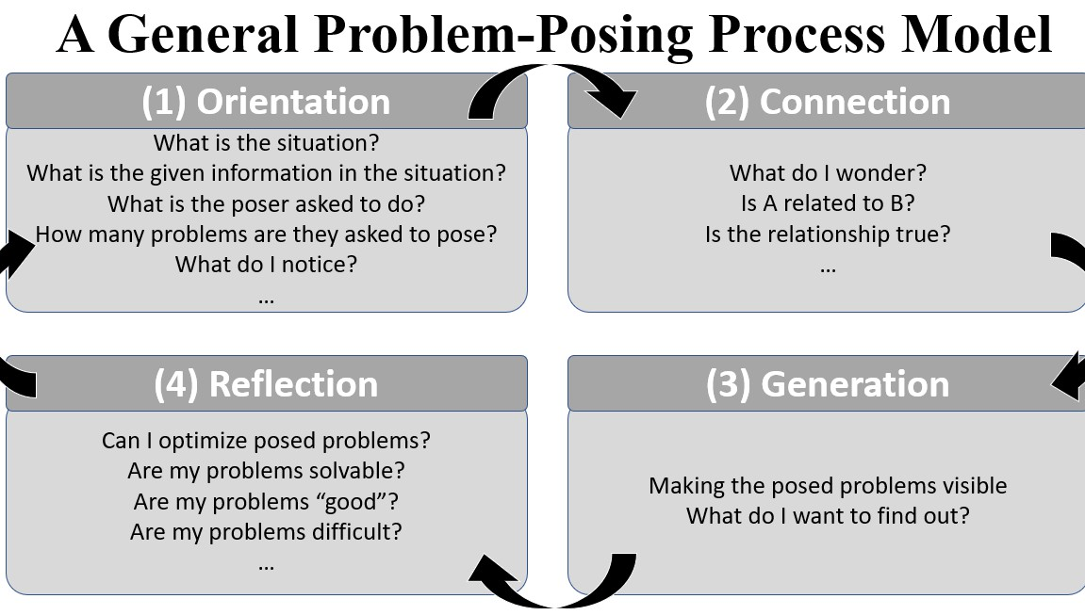
Cai & Rott, 2024

Slide 52
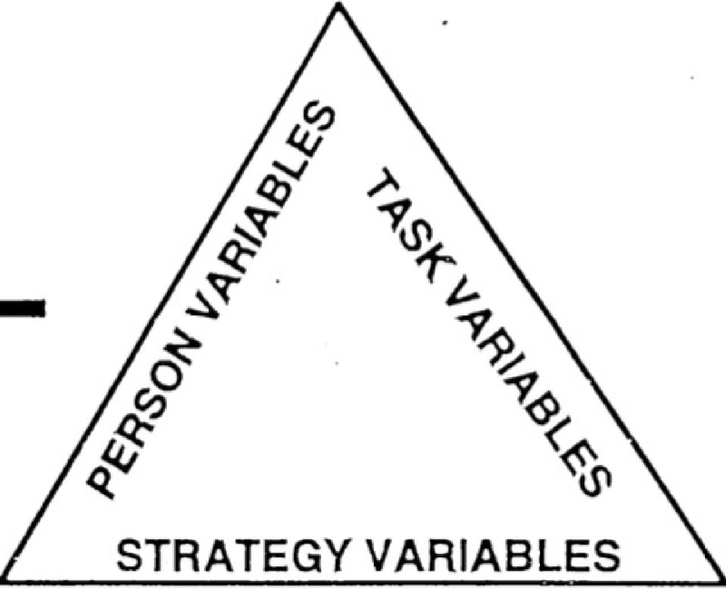

l\1E'TACOGNITIVE COMPONENT
COG ¹ITIVE C01\1PONENT
--
I
ORIENTATION
I
I
,
..
I
:
.
1:
1:
I
VER,IFICATION
I
I
I
,QRGA'NIZATION
I I
I I
11
EXECUTION
.
.
- -
Figure 1. Garafola and Lester's (1985) cognifive-metacognitiv,e model.
- �...
..
-===--111181;;--�,.:.inh:�d with nP.rmis.�ion from rnurnal·[nr Rit�.c;earch in Mathe.1ftafir-s P.du�atinn_

Slide 53
Step 1: Teacher presents the situation
Real life
Mathematics Other
Quantity
Difficulty Other
Step 2: Teacher presents the problem-posing prompt
Independent
Small Group
Step 3: Students pose problems
Analyze
Select
Sequence Solve
Step 4: Teacher and students handle responses
Cai, 2022, 2025

Slide 54
Handling Students’ Responses
Teachers analyze, select, sequence, and
solve posed problems (Cai et al., 2024).
Zhang & Cai, 2021 found:
  Goal-aligned problems are prioritized for discussion
  Harder problems often assigned as homework

Slide 55
Handling Responses
Analyze: Categorize and clarify
Select: Based on learning goals
Sequence: Order by cognitive demand
Solve: Focus on reinforcing math ideas

Slide 56
Example: Percent Lesson
(Ma & Cai, 2024)
Students pose problems using: 40, 50, and %
Problems are classified into known types.
Some problems revised for realism (e.g., whole numbers)

Slide 57
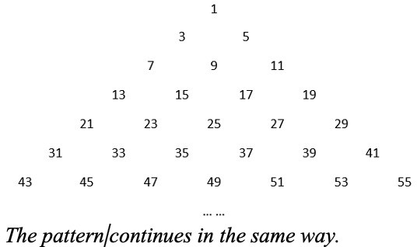
Odd Number Pattern Task
(Cai et al., 2024)

Slide 58
Classification
Classifying problem types helps students compare & generalize.
Clarifying ambiguous problems encourages critical revision.
Even “unexpected” responses can be useful when refined.
Ran, H., Cai, J., Muirhead, F., & Hwang, S. (2025). An analysis of unexpected responses in middle school students’ mathematical problem posing from the perspective of problem-posing processes. Educational Studies in Mathematics, 119, 467–486.

Slide 59
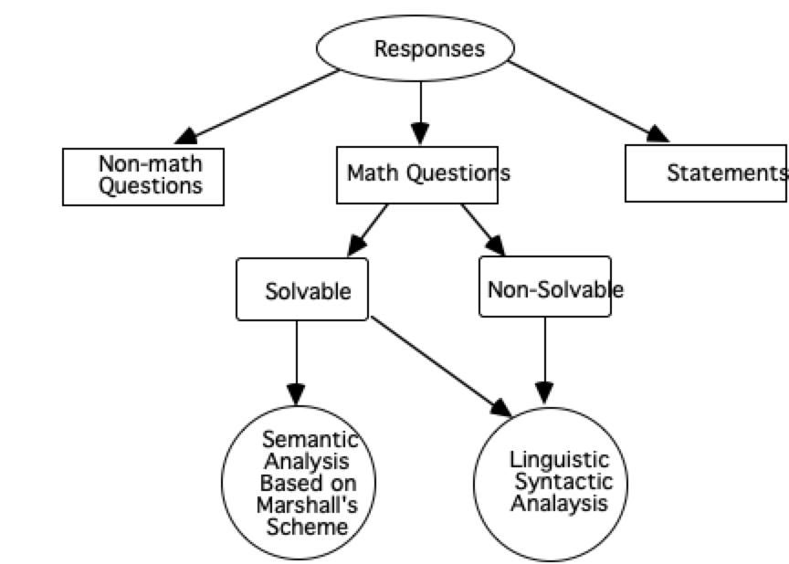
About 75%
(Silver&Cai, 1996)

Slide 60
Meta-Analysis
Ran, H., Cai, J., Hwang, S., Han, J., Ma, Y., & Muirhead, F. (2025). Effects of engaging in problem-posing interventions on learners’ cognitive mathematics outcomes: a comprehensive meta-analysis. Journal for Research in Mathematics Education. 56 (5), 259–282
Outcomes | Hedges’ g
Overall effect | 0.53
Problem posing | 0.84
Problem solving | 0.52
Mathematics achievement Affective outcome | 0.25 0.67

Slide 61
Measuring Changes
Teachers’ beliefs
Teachers’ lessons (improvement science)
Their students’ growth in cognitive and affective measures

Slide 62
Teacher Changes
Feel much more comfortable with problem posing in classroom
More lessons involving problem posing
Using more problem-posing tasks

Slide 63
Teachers’ Perceived Advantages and Challenges
ar 1
For teachers For students
Cognitive Affective Social
Cognitive Affective Social

Slide 64
Mathematical Understanding and Problem Solving
I was impressed … how they were engaged and what level of questions they came up with but after they were more focused on the content of the concepts of circles.
[My students ask] more types of questions that involve a deeper level such as why and how. Questions that make them
think or solve it before they can come to a conclusion or answer. I love how my students want to challenge themselves as well as others to come up with harder problems and not easy types of questions.
I incorporated problem posing into my cool downs … by having my students think about mistakes that others could make on an exponent number line and create a new problem that might help students understand their misconceptions.

Slide 65
Student Engagement
I noticed myself offering problem posing almost on a daily basis. This year I see students taking more responsibility in their own learning, and some have even told me that this year they have felt more comfortable in their math skills than in the past
They especially like it when we use [problem posing] as an
entrance activity and their problems/questions are extremely similar to ones that were in the textbook. This has really helped them connect to the material and engage more with the lesson.
I noticed that shy students or students that have the mindset
that “math is hard” were able to participate and show off their talents to me with enthusiasm, knowing that they may see their problem on an assignment.

Slide 66
Future

Slide 67






Investigating longitudinally how teachers learn to teach mathematics through Problem Posing and its impact on on classroom instruction and students’ learning.
Increase Knowledge
Teacher Learning
Change Instruction
Improve Students’ Learning
Change Beliefs

Slide 68
Longitudinal Effect (Cai et al. in preparation)
How might the thinking of female and male students new to problem posing in school mathematics differ?
Do male and female students participating in the P-PBL program exhibit different patterns of growth over 1 and 2 years?

Slide 69
Longitudinal Effect
1. Female students who were new to problem posing performed significantly better than male students who were also new to problem posing, after controlling for the state mathematics assessment scores.

Slide 70
Longitudinal Effect
Female students who were new to problem posing performed significantly better than male students who were also new to problem posing, after controlling for the state mathematics assessment scores.
Female students who stayed in the program for either 1 year or 2 years were found to have larger increases in problem-posing scores compared to those of male students. Female students began the program with higher problem-posing scores than male students and these gender differences increased during the program for 1 year and 2 years because the growth rate of female students’ problem-posing scores was larger than that of male students

Slide 71
Future Research Directions
Develop problem-posing tasks
Study cognitive/affective processes (e.g., via eye-tracking)
Support teachers learning to implement posing
Measure teacher changes
Investigate long-term effects of problem posing on students’ understanding and affect
Integrate problem posing into other areas, such as modeling

Slide 72
An Analysis of Modeling Tasks
Educational Studies in Mathematics, 2022, 109 (2), February 2022. Innovations in measuring and fostering modelling competencies (by Gabriele Kaiser & Stanislaw Schukajlow)
ZDM – Mathematics Education, 2018, 50(1-2), Empirical research on the teaching and learning of mathematical modeling (by Gabriele Kaiser Marcelo
C. Borba, Stanislaw Schukajlow, & Gloria A. Stillman
9 Books in Book Series on International Perspectives on the Teaching and Learning of Mathematical Modelling (by Gabriele Kaiser)

Slide 73
Problem Posing and Math Modeling
There are a total of 213 modeling tasks included in ESM Special Issue, ZDM Special Issue, and the nine books in the modeling book series
12 of these 213 modeling tasks required explicitly problem formulation, which is about (5.6%)
On the other hand, 44 modeling cycles used all requiring problem formulation
Cai, J. et al. (2026). Problem Posing and Mathematical Modeling: A Proposal for Conducting Modeling Research Involving Problem Posing. Journal for Research in Mathematics Education. 57(4), 179–187

Slide 74
AI-enhanced problem posing, analysis of student posed problems, and P-PBL lessons

Slide 75
AI-Enhanced P-PBL
Developing PP Tasks
Scoring
Feedback to teachers
Peer learner
Discourse simulation

Slide 76
Developing PP Tasks
Dai et al (2026) in Science Education
  Results showed that the use of chatbots significantly improved problem quality (t = 2.47, p= 0.015) and overall problem posing ability (t
= 3.07, p = 0.003)
Design problem-posing tasks using AI in my own classes (Cai, 2026)

Slide 77

Grain of Rice

Slide 78
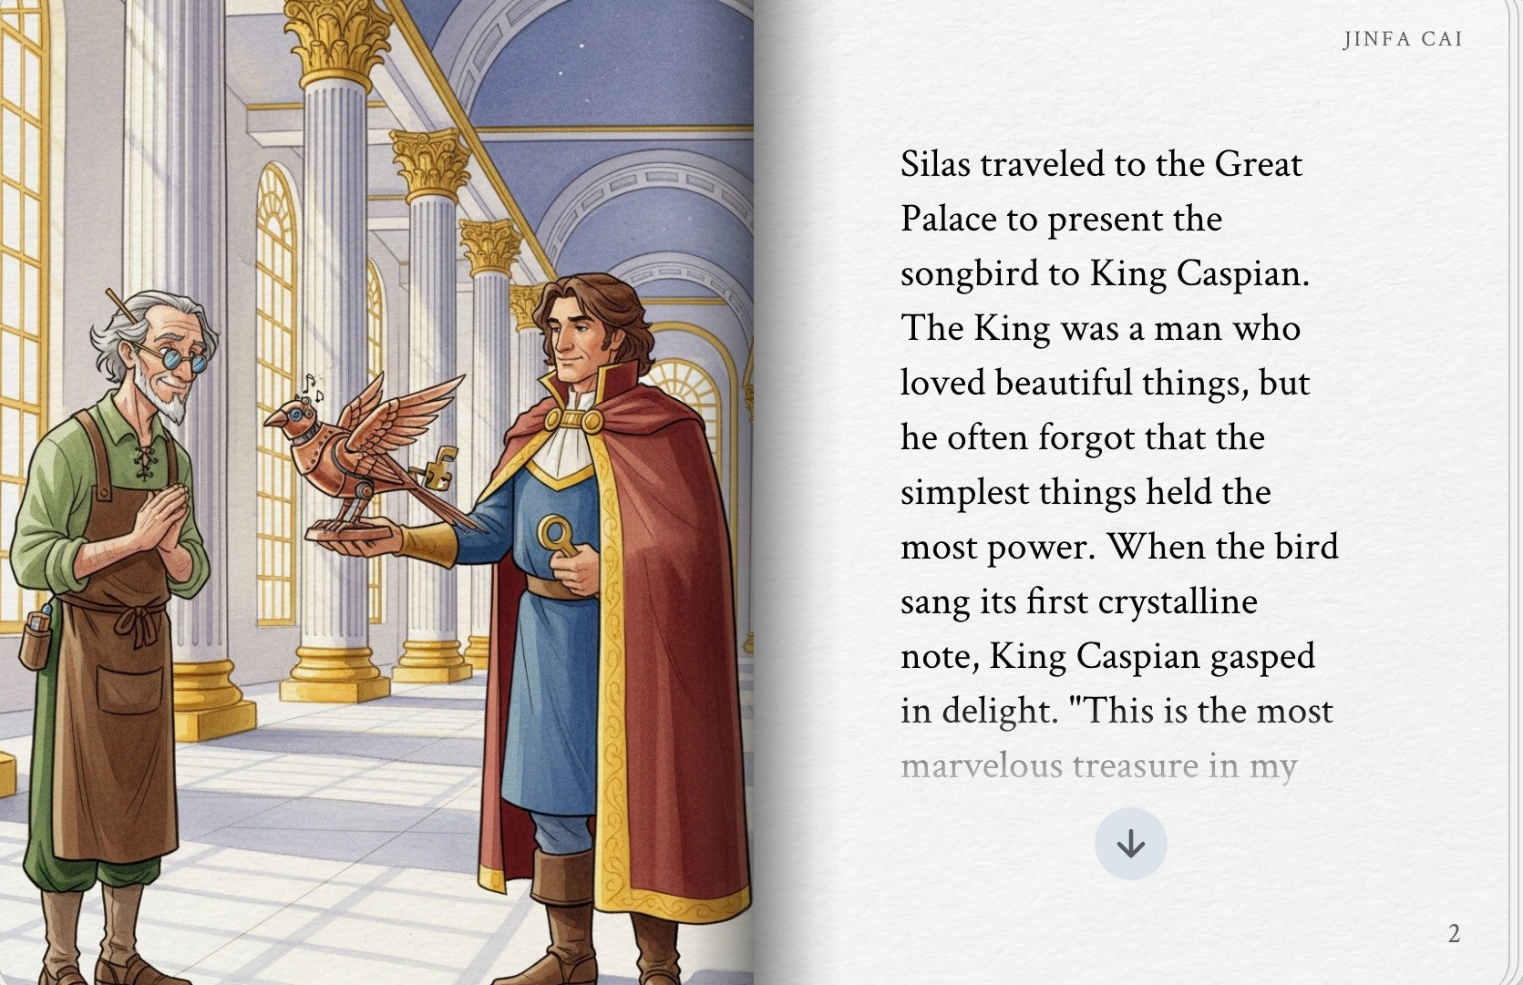
Grain of Rice

Slide 79
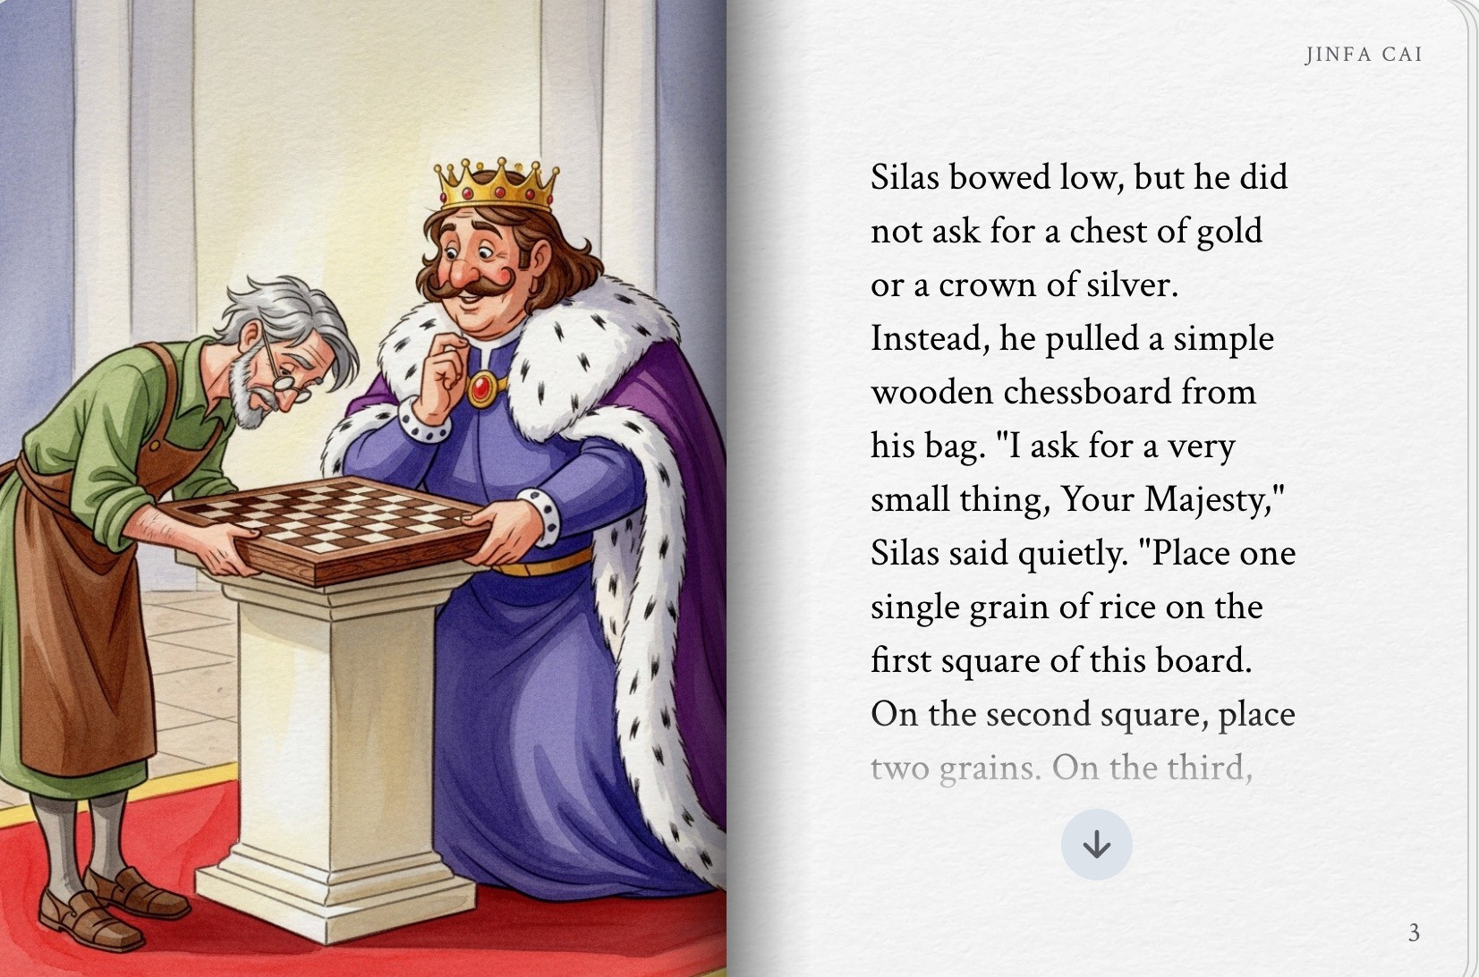
Grain of Rice

Slide 80
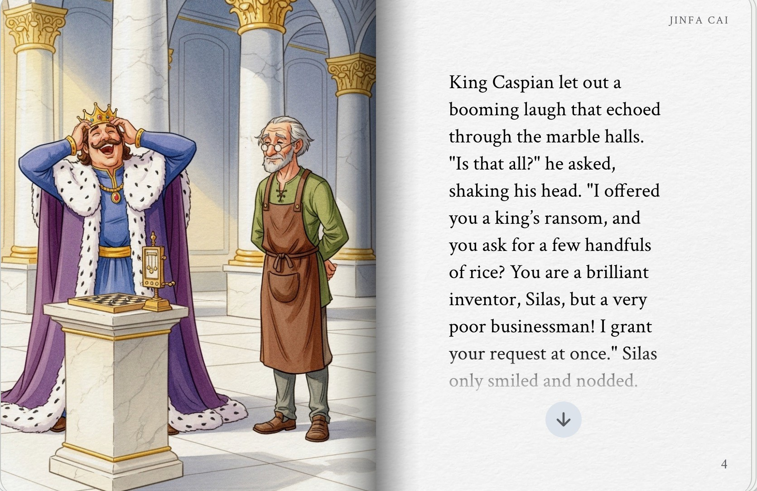
Grain of Rice

Slide 81
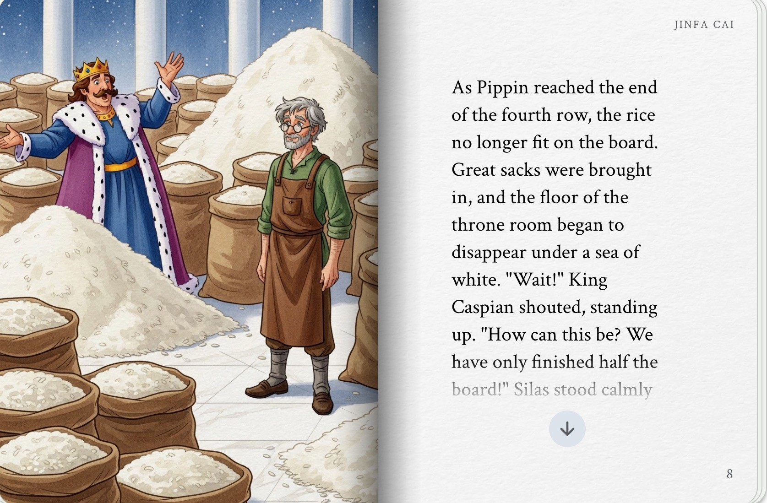
Grain of Rice

Slide 82
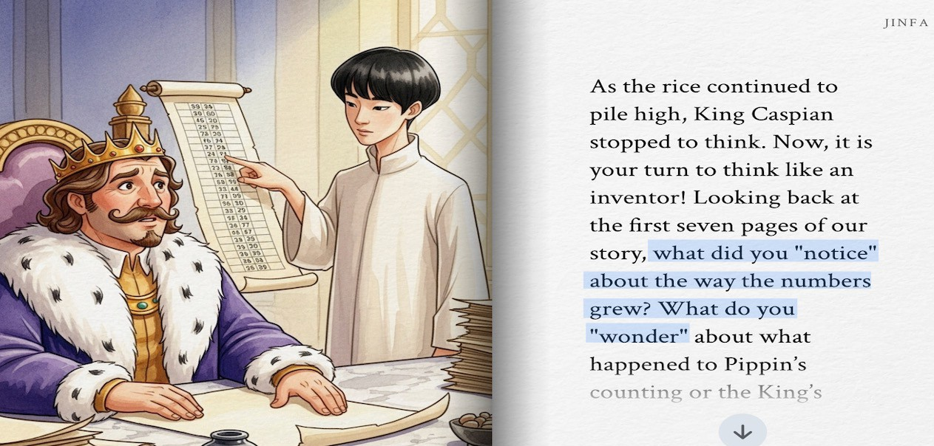
Grain of Rice

Slide 83
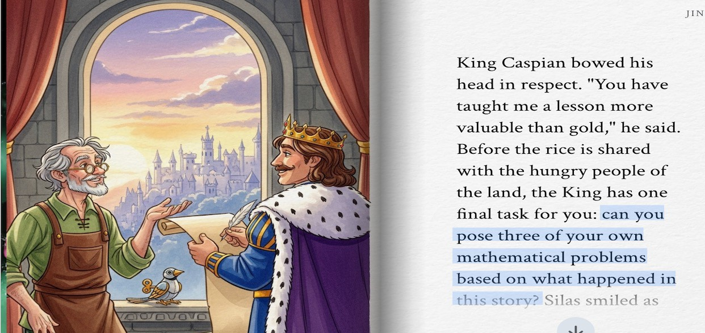
Grain of Rice

Slide 84
Grain of Rice
What do you notice?
What do you wonder?
Can you pose three of your own mathematical problems based on what happened in this story?

Slide 85
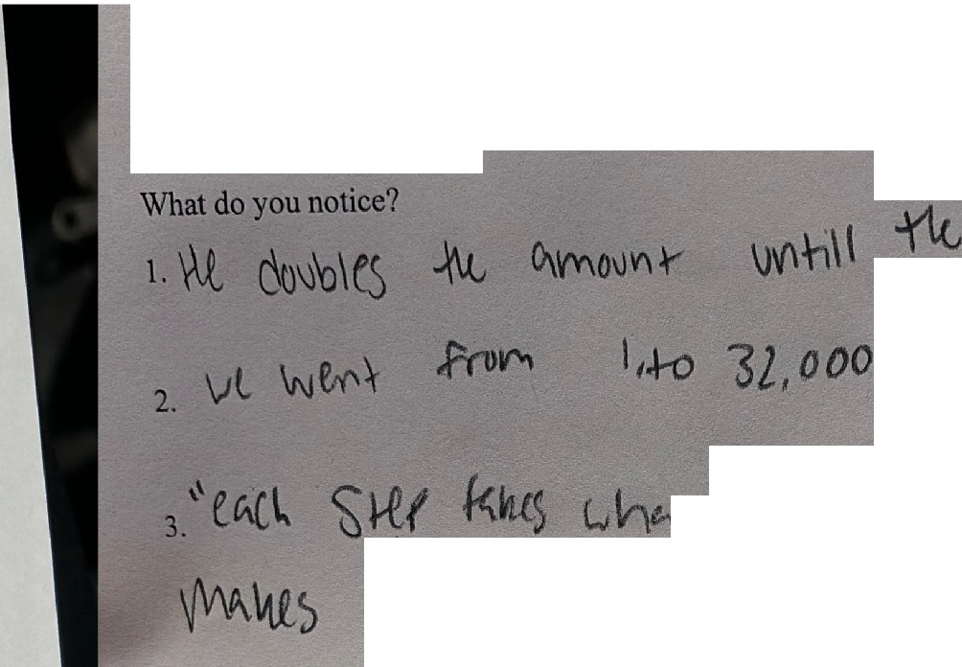



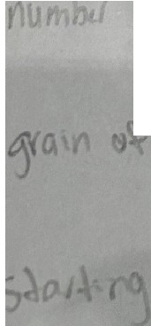
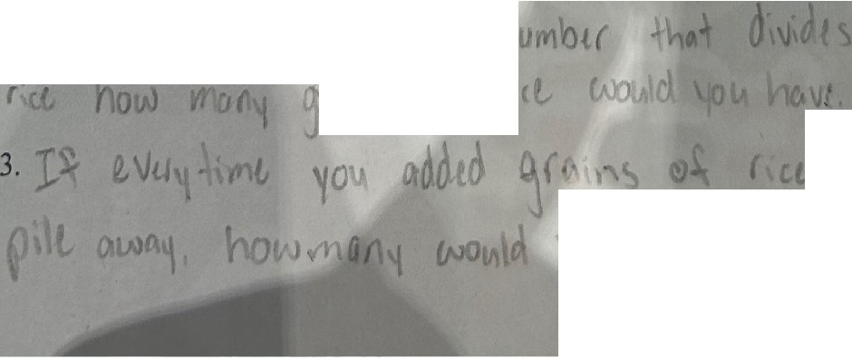
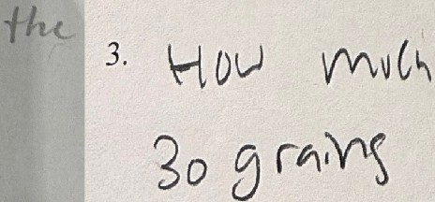


Grain bf Rice
Carefully listen to the story from the Google StoryBook by Jinfa Cai.
Grain of Rice
Carefully listen to the story from the Google StoryBook by Jinfa Cai.
r
What do you notice?
1. 1h<, j'fons o� tu
\oo1ild
Huw cl.J ;_,. J vf'\f -fJi ,1-�
�ltw rQpJI�
I
�-���he� q�
rt kW1.t '-\� v\'\Ulh .,
What do you wonder?
What do you wonder?
1. How �Q'.)\- would .\· .\C!\l,l, � th numbt1 o� t,cl �¹f1.d
1. �I) e,,t\ 'rt, Come., --:R
w \� 't'\ri,S i Jttt
2. \+ �J | t'(\,1\-J.,b | ..}¼, | 1.,J\.,O\<'. boet(cl | HcJv-l MtJ{h | Yiu,
WOv\e- � | b.e�
I
did {} Vht;}W W,,ti r 5p,,ee, c,.t,,h
3
boc,lcJ
ht, Pv>r- i.i--- t:1n �
Can you pose three of your own mathematical problems based on what happened in this story?
_{Can you pose three Of your O}wn mathematical problems based on what happened in this
story?
In. \/)') 100 o\
daub\ , �(ju 1"'>
iA.aO
�rd
1. .,\..y�
\JI(� l i 9 rnh5
of rite
w�.J-- lJ ti.f
-he_.
1
Ou nooJ1.. on Q. �i"\ J I<
0tMourv kw-t n,, dov'oI-<d �
.,
2. ::: tVH , -<.,
l()u t 0.
{IP O
2
- (�.
V\i\0l'1\1 � rill WI l t � �JV' duvbHnJ l20tJ :
l.f- wt
r1·1t w0vld
of n-lc 7
OU

Slide 86
Scoring
Three studies
Prompt engineering is the process of crafting and optimizing the instructions you give to an AI model to elicit the exact response you need, without changing the model itself.
Fine-tuning is the process of taking an existing model and training it on a specialized dataset to alter its fundamental behavior or teach it domain-specific skills

Slide 87
Process Method
Revise and review the prompt
Low agreement level
Low agreement level
Test the (revised) prompt
Evaluate the prompt
Validate the prompt
Write the prompt
High agreement level
Maintain high agreement level

Slide 88
Feedback to Teachers
The more teachers know students’ thinking, the better teachers can teach for students’ understanding
Assessment data is delayed
With the help of AI, we can provide in-the-moment information to teachers in classroom
  More advanced in science education
  We are catching up in math education

Slide 89
Collaborative Research: AI-Enhanced Problem-Posing Based Learning: Supporting Mathematics Teachers’ In-the-Moment Instructional Decision-Making (DRL-2604452) (with Xiaoming Zhai, UGA)

Slide 90
Thank you so much!
Jinfa Cai jfcai@TAMU.edu

